Slide 1
Embedded web pages / running a web server

Slide 2


Popular frameworks
React
Angular
Vue
Svelte

Slide 3

What we will do
Create a site
Embed the website on the chip
Use our Rest endpoints

Slide 4
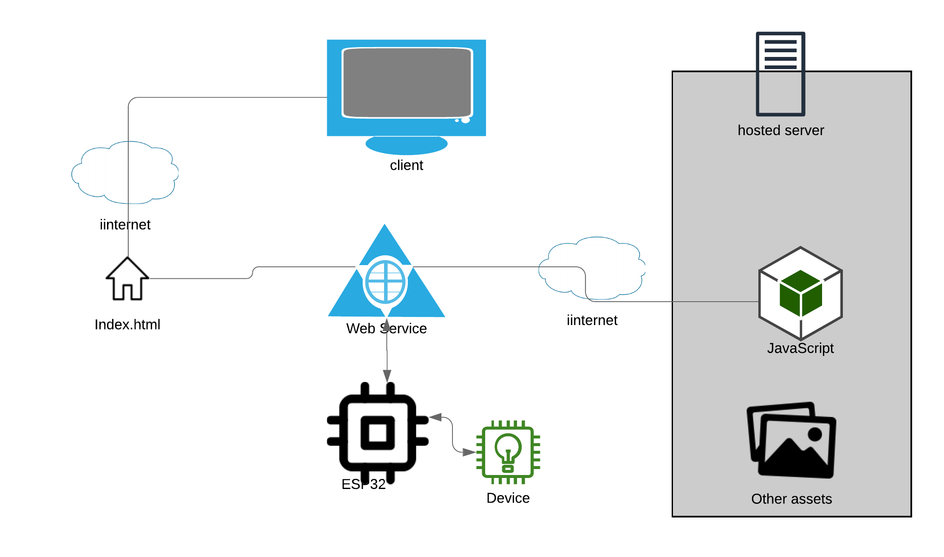
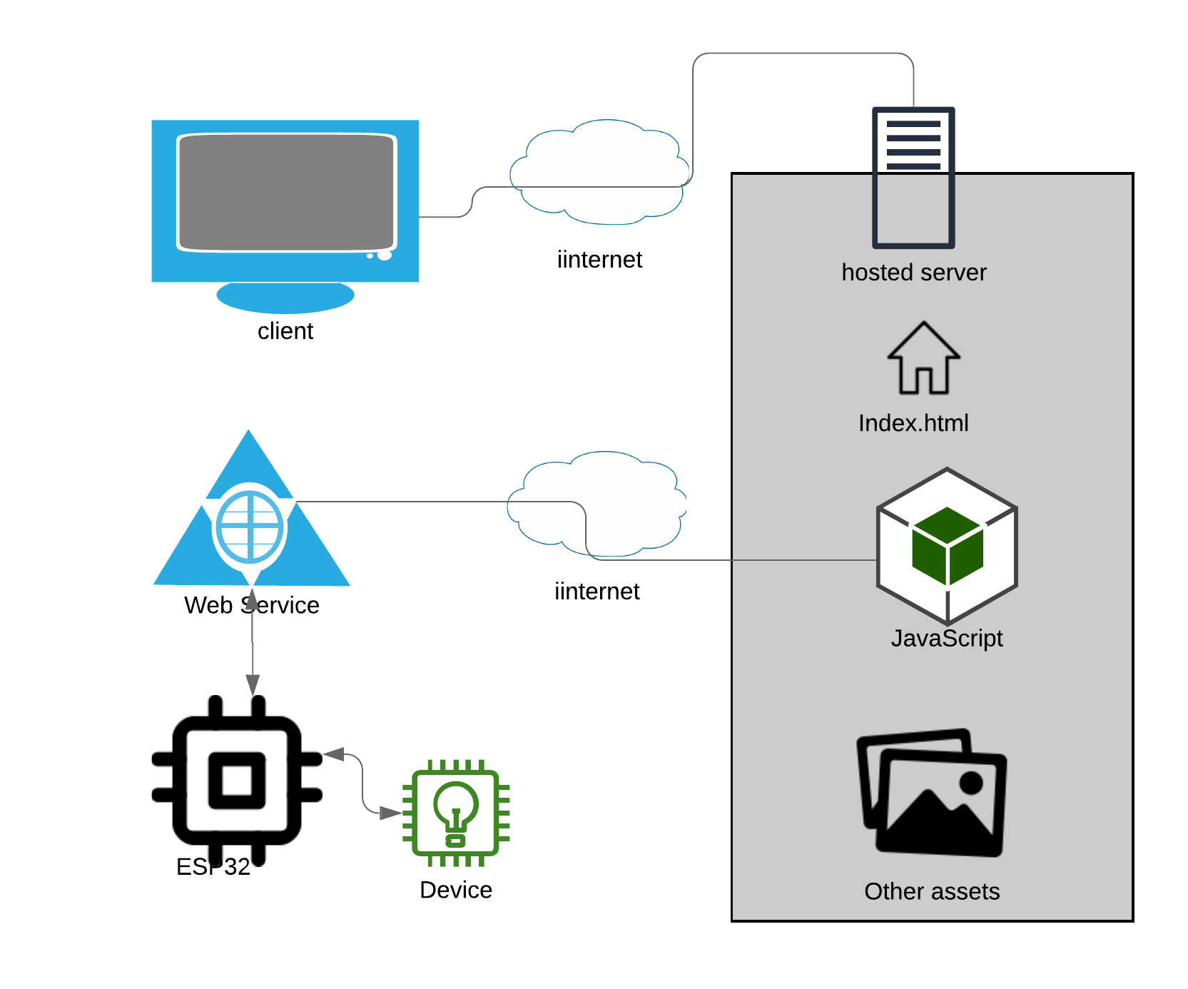
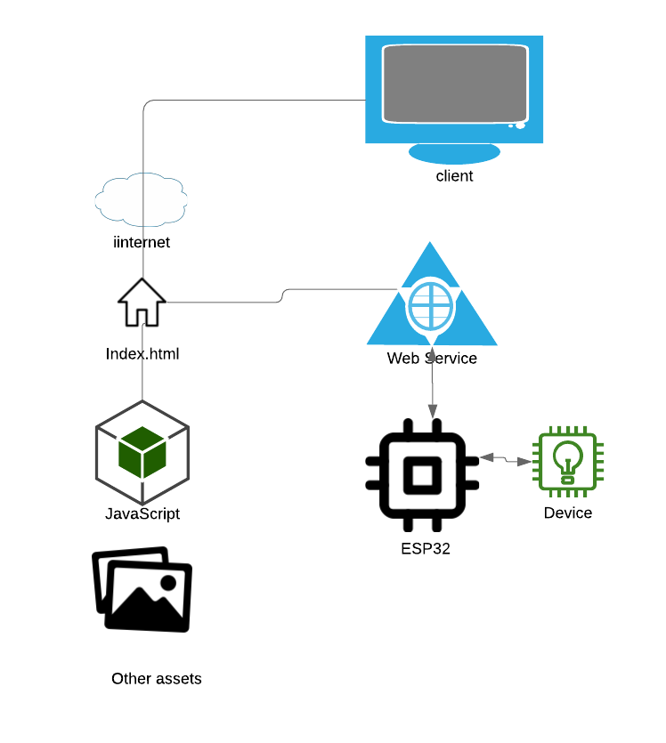
Web server options
Option 1:
ESP32 is used as a web service and does not host the website
Option 2:
ESP32 hosts index page. Other assets are hosted on a CDN
Option 3:
All assets are hosted on the ESP32

Slide 5
Steps to take
Configure storage (spiffs, SD Card etc)
Configure wild card route for pages
Write code to serve the pages by matching the URL to the path in storage

